Slide 1
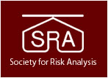
Welcome to the SRA 2017
Advancing the Science Webinar Series
Microbiota Informing Next-Generation Risks & Benefits
All SRA webinars are available to SRA members as videos after the webinars at SRA.org
(with log-in as a member).

Slide 2
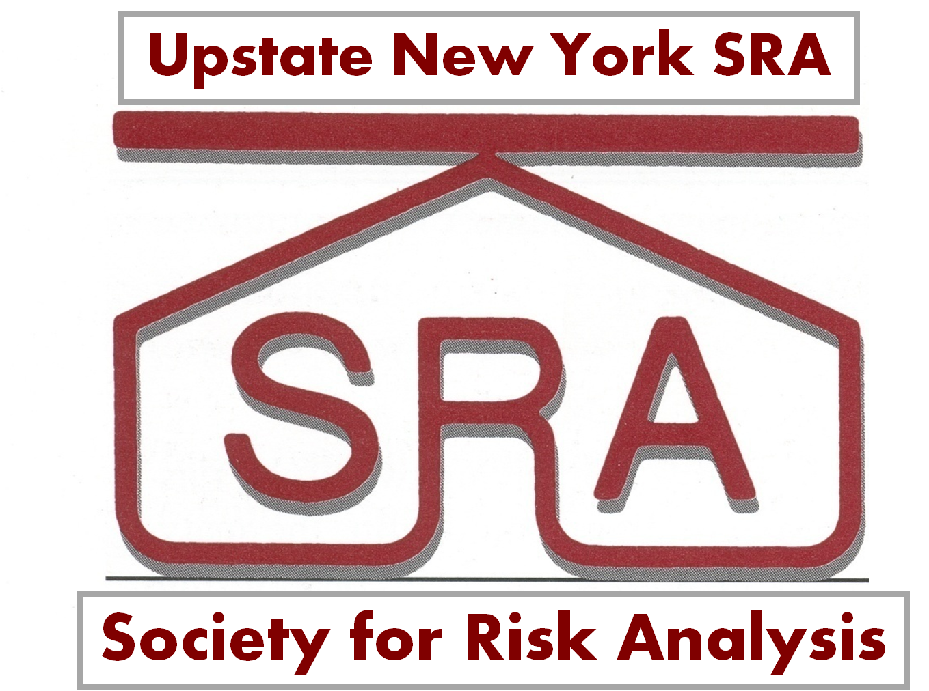

Preparing to Deliberate Evidence on Benefits and Risks Posed by the Microbiota of Milks
Peg Coleman, Warner North, and SRA RO Collaborators

Slide 3
Introduction
Warner North
About the Society for Risk Analysis (SRA)
Analytic-Deliberative Process – Dialogue in support of environmental/health risk assessment and decision making

Slide 4
The Society for Risk Analysis
Interdisciplinary: physical sciences, biological sciences, social sciences, engineering – an “Open Forum” for discussion on risks.
Scope:
  Risk assessment – magnitude and likelihood of adverse consequences, such as to health and the environment;
  Risk management – decision making on management of risk (engineering /normative support to those with decision responsibility)
  Risk perception and risk communication – behavioral science on how people think about risk, communicate about risk, and act on risk.
International: Parent Society plus Regional Organizations (25 = 14 outside USA; 11 in USA) and Specialty Groups (15). (Details on www.sra.org.)

Slide 5
Peg Coleman and Warner North
Peg Coleman Website: http://www.colemanscientific.org/;
E-mail colemanmellen@gmail.com.
  Upstate New York State SRA President
  Member of Editorial Board for Risk Analysis, An International Journal
  Microbial Risk Assessment and Dose-Response Specialty Groups; Background in microbiology and microbial risk assessment
Warner North Website: www.northworks.net;
E-mail: northworks@mindspring.com.
  SRA President 1991-1992
  Area Editor for decision sciences, Risk Analysis, An International Journal
  Background in physics, decision analysis, probabilistic modeling

Slide 6

Analytic – Deliberative Process
Term from 1996 report of the US National Academies of Science, Engineering, and Medicine (NASEM): Understanding Risk: Informing Decisions in a Democratic Society (1996) https://www.nap.edu/catalog/5138/
See also the 2008 NASEM Report, Public Participation in Environmental Assessment and Decision Making (2008) https://www.nap.edu/catalog/12434/
FOCUS: Regulatory controversy in areas with complex emerging scientific information and diverse views among the interested and affected parties in the public – the “stakeholders.”
Recent US application: 2013 NASEM workshops and subsequent publication, 2014 special issue in Environmental Science and Technology, on enhanced natural gas recovery from tight formations (“fracking”)
Appropriate for “milk wars” – Risk management for microbiota of milks.

Slide 7
Stakeholder Involvement
Many people have interpreted recommendations for stakeholder involvement as letting stakeholders speak, letting them write comments, and (perhaps) letting them have seats at the negotiating table.
The main Understanding Risk recommendation is for involving stakeholders in an analytic-deliberative process. This means going beyond words and political negotiation. It means giving stakeholders opportunities to observe, learn, and comment in an iterative process of analysis and deliberation on policy alternatives.

Slide 8
Process Diagram from Understanding Risk
(1996; page 28)
Insert Fig page 28 of UR

Slide 9
Five Key Points
Getting the science right
Getting the right science
Getting the right participation
Getting the participation right
Developing an accurate, balanced, and informative synthesis.
(Understanding Risk, 1996; pages 6-7)

Slide 10
Now, over to Peg Coleman

Slide 11
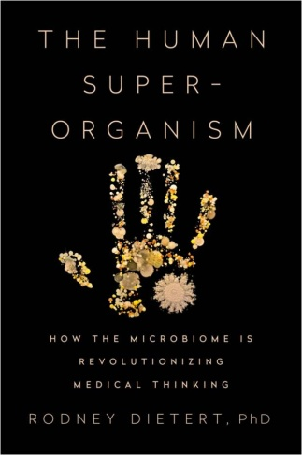
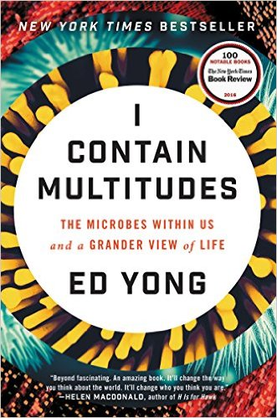
Living in Microbial Ecosystems
Bacteria are all around (and inside) us!
Microbiota are symbiotic, commensal or mutualistic partners,
with few pathogens that may cause disease with
disturbance of ecosystems (dysbiosis).
Homo sapiens + microbiota =
human ‘superorganism’,
holobiont, ‘supraorganism’
Earth’s ecosystems are full of ’superorganisms’
containing Multitudes of microbiota. New medical landscape emerging in 21st century, with microbial ecology challenging assumptions about health and disease.
2016
2016

Slide 12
Immunology in 21st Century
Classical portrait:
  Surveillance and destruction of pathogens
Emerging insights for ‘superorganisms’:
  ‘Microimmunosome’ includes dense and diverse microbiota that synergistically and cooperatively protects against pathogens
  Joint management of our relationships with our resident microbes, particularly at mucosal epithelia
    Thousands of commensals (Firmicutes, Bacteriodetes, Actinobacteria, Proteobacteria phyla) contribute to mucosal immune homeostasis in the gut
  Alliances not fixed, but change with context
    commensals can express mutualism or pathogenicity under certain conditions
2016
2016

Slide 13
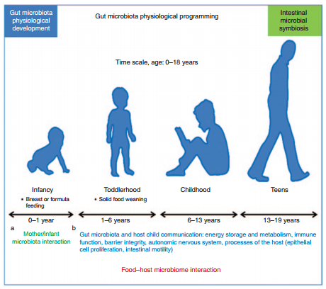
Microbiota, Ecosystems, and Risk
As expected for ecosystems,
microbial communities change over time
and space
Predicting risk of illness is complex and
uncertain (e.g., age, doses of pathogens,
environment, foods, health status,
medications, nutrition, stress, water)
Perceptions of risk in the media often
NOT supported by science
Perceptions of bacteria
as germs to be eradicated (germophobia)
being replaced by awareness
of fostering symbiotic partners in health
(microbiomania)
In first decade of research, knowledge of
roles of microbiota of milks is advancing
Putignani, et. al., 2014, http://www.nature.com/pr/journal/v76/n1/pdf/pr201449a.pdf

Slide 14
Milk a Mammalian Innovation
200 Million-Year-Old ‘Superfood’ (Yong, 2016)
Human milk
  Emphasis on human milk waxed and waned over recent centuries, but now
  maternal milk recommended from birth and for two years or more
  Wet nursing ancient practice in many cultures (Code of Hammurabi from 2250 BC)
  Recent establishment of human donor milk banks (e.g., HMBANA established 1985; https://www.hmbana.org/about-hmbana) for care of at-risk infants (very low birth weight, premature, ill)
    Early 20th century donor milk unprocessed, now pasteurized (WHO/UNICEF, 1980)
Non-human milks were produced and consumed for millennia,
with domestication of cows ~8000 BC
  Industrialization and distribution to cities began to raise issues for safe milks
  in the US and around the world by the 19th century
Joint SRA Project: deliberating evidence, particularly from past decade, on benefits and risks associated with microbiota of milks
2016

Slide 15
Effects of Pasteurization on Human Milk
Failure of infants to thrive, significantly more infections
Reduced inhibition of pathogens
Inactivation or destruction of:
  All immune cells
  Immunoglobulins
    Secretory IgA reduced <33%
    IgG reduced ~70%
    IgM completely inactivated
  Lactoferrrin reduced 20%
  Proteins (B-12 and folate-binder proteins) reduced/denatured 13%
  Enzymes (e.g., lactoperoxidase, lysozyme) reduced 75%
  Vitamins A, B-complex, C
  Human milk oligosaccharides (HMOs)?
  Microbiota, including commensal and beneficial (probiotic) strains
(Narayanan et al., 1984; Stein, 1986; Unger, 2010; Gyselet al.,
2012; Koenig et al., 2015; McGuire et al., 2017)

Slide 16
Outline: Closing 2017 Webinar Series
Microbiological discoveries (advancing knowledge of
microbial ecology; Ed Yong, 2016)
  Next-Gen risk assessment, risk communication, risk management
‘Milk wars’ around the globe
  US history (Mendelson, 2011)
  Australia history
  New Zealand history
  UK history
Evidence considered in top-down and bottom-up approaches
(bottom up considers microbial ecology of foods and gastrointestinal
tract and dose-response relationships)
2016

Slide 17
Early Microbiological Discoveries Impacting the Milk Wars
1840
L. Pasteur
1908
E. Metchnikoff
J.R. Crewe
Milk Cure (1929)
1665
A. van Leeuwenhoek
Father of Delft School
Microbiology, Micrographia,
Fellow of Royal Society
scientific guild (1680)
R. Koch
Germ theory, silkworm pathogens (1860s)
Germ theory for anthrax, casts microbes as avatars of death (1870s)
Symbiotic bacteria (probiotics) in fermented milks associated with longevity
Russian Nobel laureate
Koch’s postulates
Mayo Foundation
Ed Yong, 2017

Slide 18
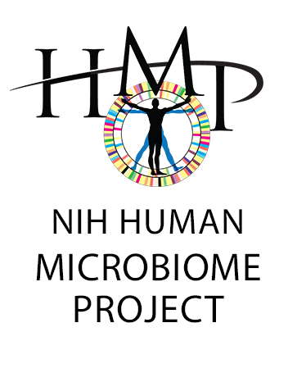
Later Microbiological Discoveries Paving Path for
Microbiome Studies
1960
2007
Human Microbiome Project
R. Dubos, D. Savage, R. Schaedler
Valued study of microbial symbionts
C. Woese
16S rRNA transformed taxonomy and ecology of microbes
Genetics more powerful lens than physical traits
True census of microbes, culture independent
T. Rosebury
Microorganisms Indigenous to Man (1962)
Ed Yong, 2017

Slide 19
Path for Microbiome Studies
Ed Yong, 2017
“history of warfare always proves more glamorous that accounts of co-operation… no one has made a success story of the useful role played by microbes in the intestine…”
R. Dubois (1948)
Discovery of 16S rRNA as taxonomic tool, both descriptive and functional
Genetics more powerful lens than physical traits (phenotype)
Library for 30 microbes compiled by 1976
True census of microbes, independent of ability to isolate and culture; birth of –omics disciplines
C. Woese (1970s)
Metagenomics most important discovery since invention of microscope.
Transformed microbial ecology from moribund science to sophisticated experimental discipline quantitating ecosystem relationships
N. Pace (~2000- present)

Slide 20
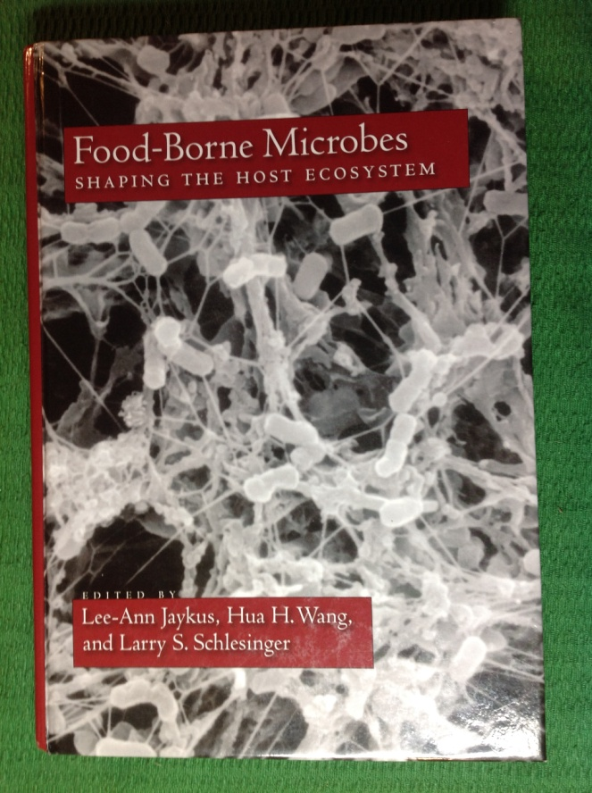

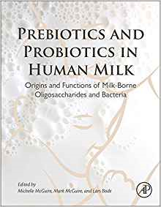
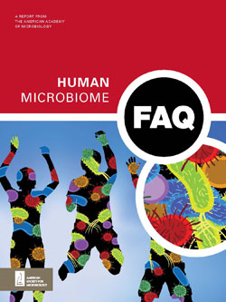
Recent Microbiological Discoveries Advancing
Microbial Ecology
2007
Human Microbiome Project initiated
First human milk microbiome paper (2011)
First bovine milk microbiome papers (2013)
2017
Micropia museum opened in Amsterdam, influenced by work of Delft School (2014)
R. Dietert, 2016
E. Yong
Jaykus et al., 2009
M. McGuire et al.

Slide 21
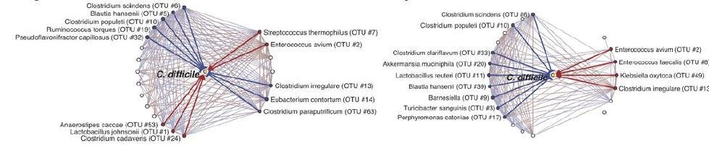
Traditional Population Ecology Meets Microbiome Research
Lotka-Volterra equations to model interspecies interactions (1925/1926) no longer apply just to
Predator-Prey interactions. Eric Pamer and colleagues now apply Lotka-Volterra equations to describe the complex interactions of consortia of microbial communities in human and mouse ‘superorganisms’.
Similar patterns from inference modeling of subnetworks of metagenomic data from humans (on left) and mice (on right).
Blue lines mark resident microbiota predicted to inhibit opportunistic pathogen Clostridium difficile growth blooms in healthy hosts.
Red lines mark dysbiotic microbiota predicted to promote C. difficile growth blooms in ill (dysbiotic) hosts. (Buffie et al., 2015)

Slide 22
2017 Advancing the Science Webinar Series Concludes
Microbiota Informing Next-Generation Risks & Benefits
Rodney Dietert (Cornell University)
Protecting the Human Superorganism
Michelle McGuire (Washington State University)
Human Milk Microbiota
Mark McGuire (University of Idaho)
Bovine Milk Microbiota
Warner North and Peg Coleman (NorthWorks and Coleman Scientific Consulting)
Preparing to Deliberate Evidence for Benefits and Risks for Microbiota of Milks
Check www.sra.org/upstateny/ for slide sets from webinars above, handout from SRA symposium (December 12, 2017, Arlington, VA), updates on project

Slide 23
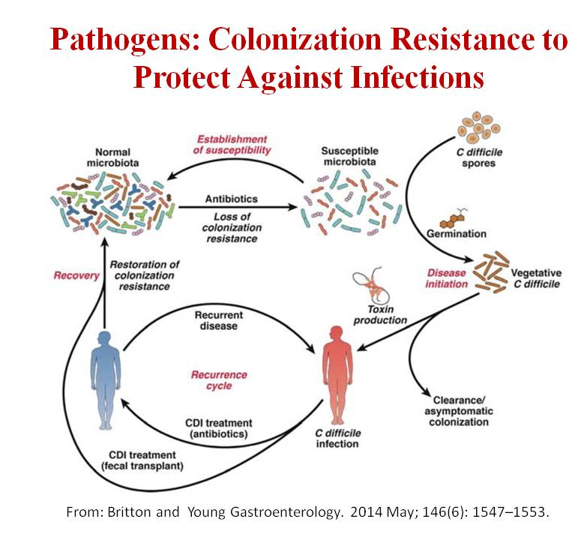
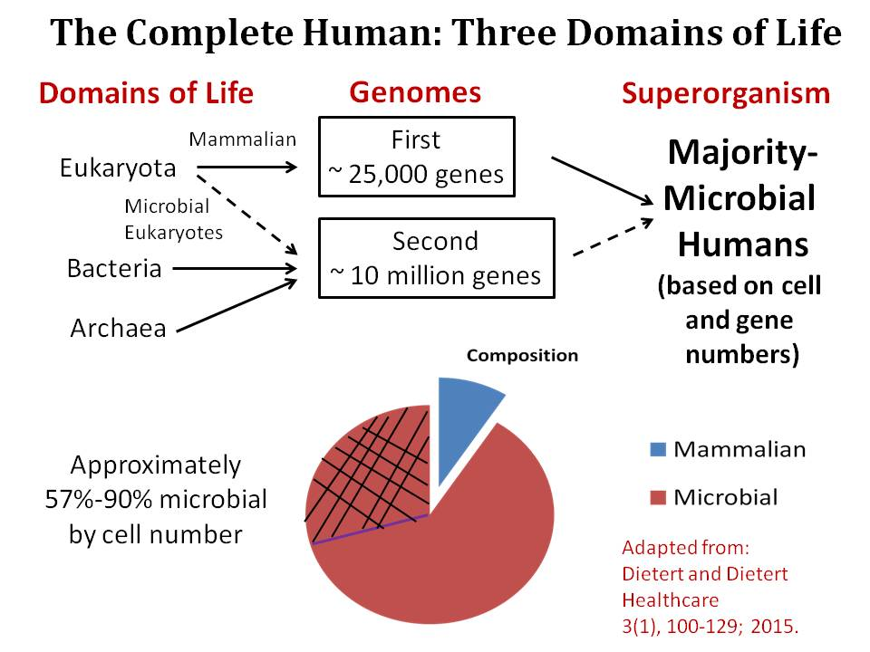
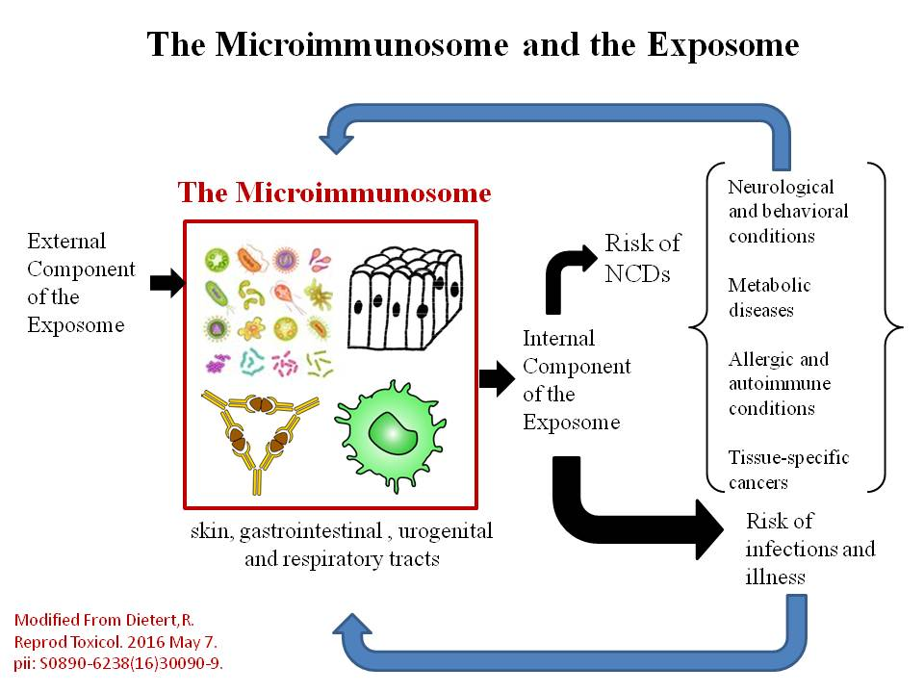
Learnings on Human Superorganism
Breast Milk Microbiota and Natural Childbirth as Preventative Measures of Immune-Microbiome Dysbiosis and Misregulated Inflammation
Dietert 2013
Microbial Partners in Human Superorganism Essential to Healthy Gut and Immune Systems

Slide 24
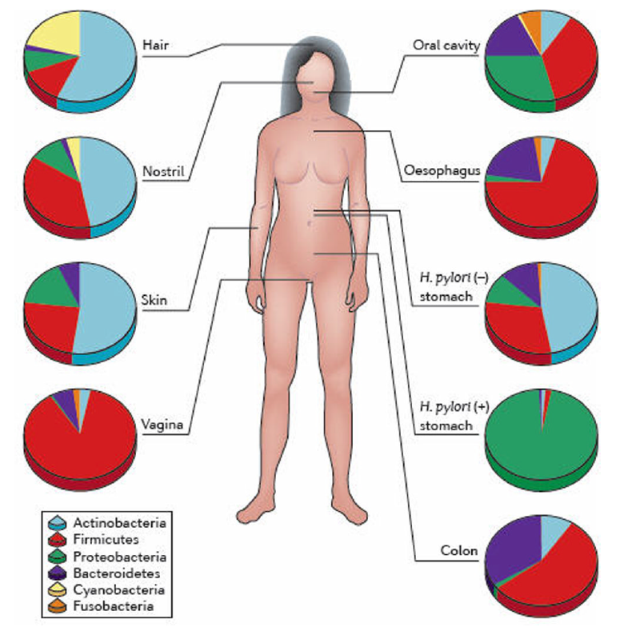

Learnings about Human Milk Microbiota
Human Microbiome Project (HMP):
nine body sites initially examined (NOT breast)
Results continue to challenge dogma:
  Breast tissue expected to be sterile, now known
  to be FALSE assumption!
  (Urbaniak et al., 2014)
  Milk microbiota NOT contaminants!
  (Hunt et al., 2011; Rodriquez, 2014;
  Addis et al., 2016; McGuire et al., 2017)
(Cho and Blaser, 2012)

Slide 25
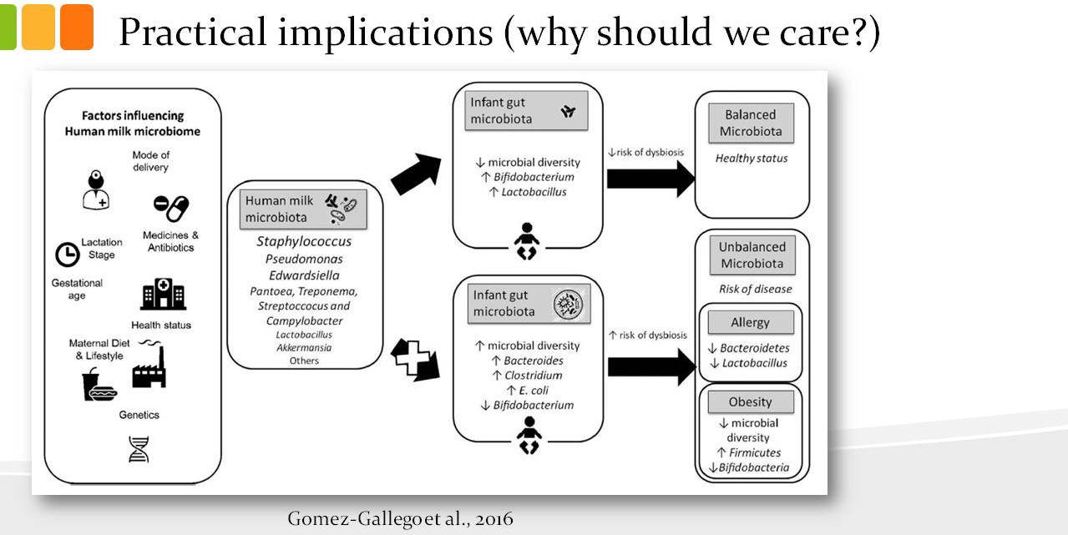
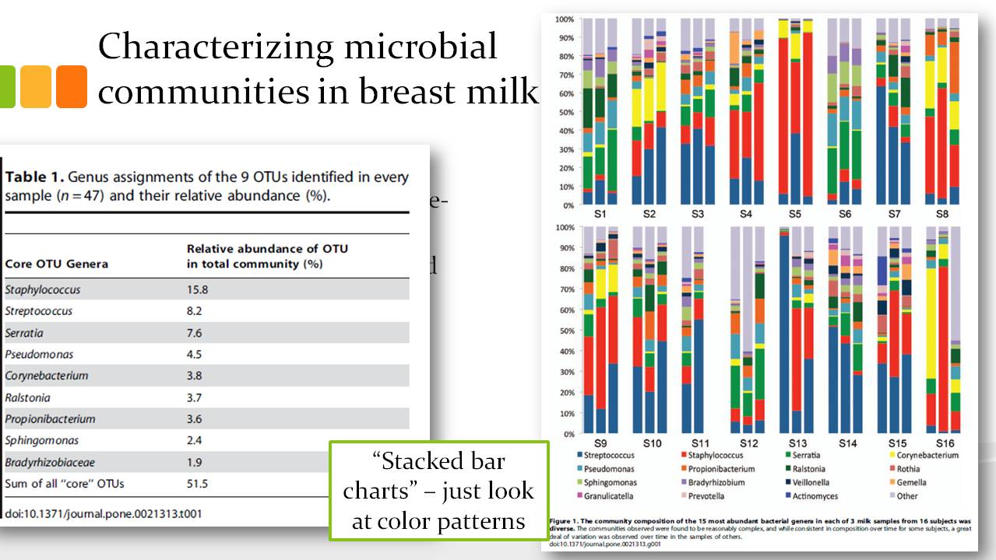
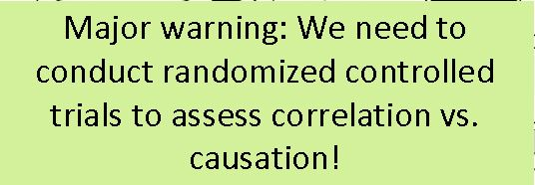
Learnings about Human Milk Microbiota
Milk Living Food with Dense Diverse Bacterial Communities Linked with Development of Healthy GI Tract and Immune Systems in Offspring

Slide 26
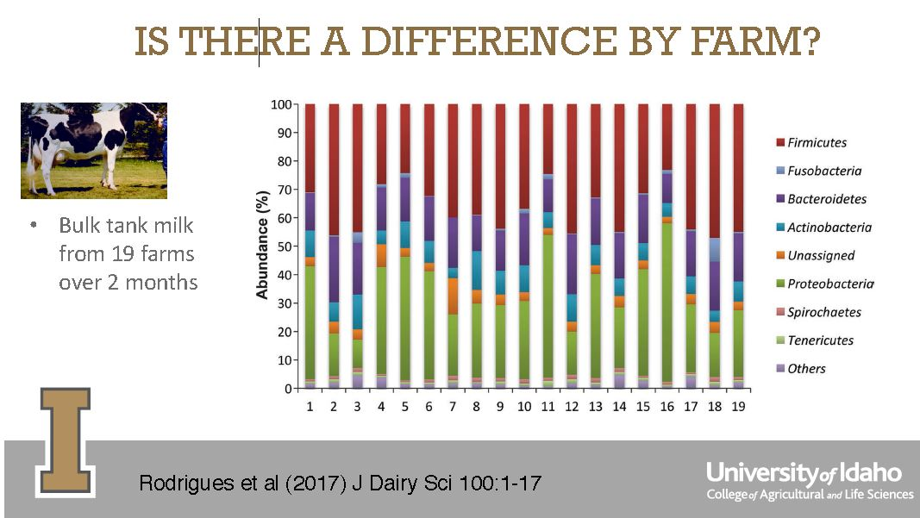
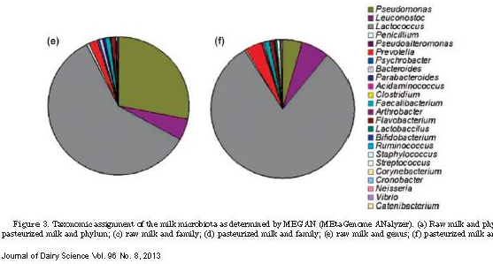
Learnings about Bovine Milk Microbiota
M. McGuire 2017
Similar genera dominate raw (e) and pasteurized (f) milk microbiota
Quigley et al. 2013

Slide 27
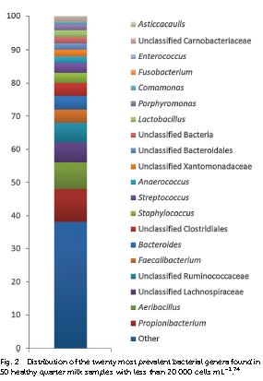
Learnings about Bovine Milk Microbiota
Milk Living Food with Dense Diverse Bacterial Communities Linked with Development of Healthy
G.I. Tract and Immune Systems in Offspring and Consumers?
Twenty Most Prevalent Bacterial Genera
Addis et al. 2016

Slide 28
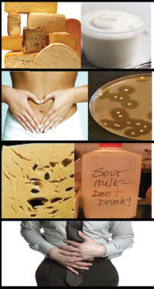
Role/significance of Some Microorganisms in Raw Milk
Food Technology
Lactococcus
Lactobacillus
Streptococcus
Leuconostoc
Enterococcus
Health Promotion
Lactococcus
Lactobacillus
Streptococcus
Leuconostoc
Enterococcus
Spoilage
Pseudomonas
Acinetobacter
Chryseobacterium
Clostridium
Illness
Listeria monocytogenes
Staphylococcus
Escherichia coli O157:H7
Campylobacter
Mycobacterium
Salmonella
Soboleva, NZ IFST 2014

Slide 29
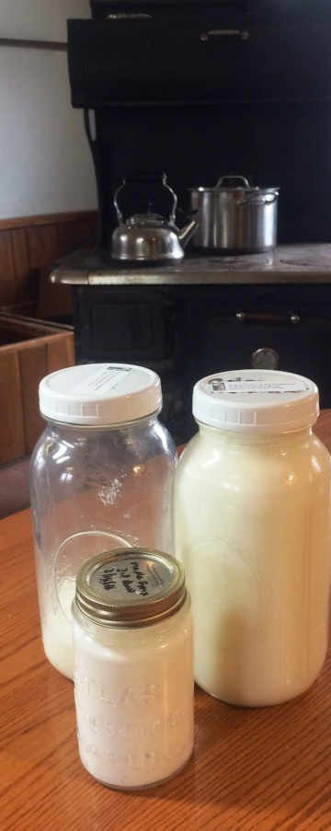
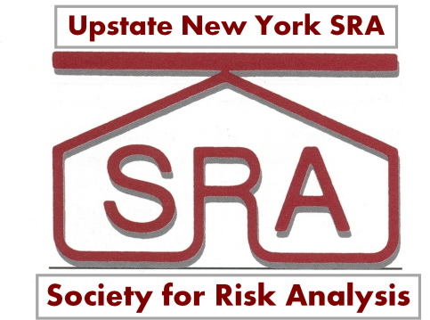
Compiling Evidence for Benefits and Risks
Many epidemiologic and microbiota studies correlative, not causal; ambiguity, complexity, confounding factors, uncertain utility for prediction
Joint SRA project will consider what we know, from both top-down and bottom-up data available, particularly
  Evidence of pathogen presence and illnesses associated with certified raw milk from licensed farms over past decade or more
  Evidence on microbial ecology of certified raw milk from licensed farms and pasteurized milks
  Evidence on microbiota of human and bovine milks influencing healthy gut and immune systems (colonization resistance)

Slide 30
Outline: Closing 2017 Webinar Series
Microbiological discoveries impacting risk assessment,
communication, and management
‘Milk wars’ around the globe
  US history (Mendelson, 2011)
  Australia history
  New Zealand history
  UK history
Evidence considered in top-down and bottom-up approaches

Slide 31
Early Highlights of the US Milk War
Ann Mendelson, 2011
  Henry Coit’s American Association of Medical Milk Commissions for certified raw milk
  Nathan Straus’ Pasteurized Milk Laboratory and distribution at public ‘depot’
  germ theory
  medical microbiology
1840
1890s
Swill milk , sick cows, sick and dying kids
Firstt opponents of the milk war in the US
Louis Pasteur and Robert Koch

Slide 32
19th Century Urbanization and ‘Swill Milk’ Industry
Ann Mendelson, 2011
Urban expansions brought challenges to distribute milk safely from farms to cities before refrigeration equipment and proper sanitation practices were developed
‘The Milk Problem’ (1840s to 1920s)
  Inner city confinement operations feeding already unhealthy cows brewery swill (spent grains) and distillery waste, producing unhealthy ‘swill milk’ associated with illness and deaths in up to 50% of children consuming it

Slide 33
“Raw Milk Kills”
Initial Opponents of the 20th Century Milk War
Ann Mendelson, 2011
Nathan Straus
Henry L. Coit
New York City Philanthropist
Son died from contaminated milk
Had no medical or scientific training
Founded Straus Pasteurized Milk Laboratory (1892) that provided milk to urban children
New Jersey Pediatrician
Son died from contaminated milk
Had physicians who were trained in dairy microbiology and sanitation supervise farm dairies
Founded the Association of American Medical Milk Commission (1893)
“Dirty Milk Kills”

Slide 34
The Continuing Milk Wars
1908
City Milk Ordinances
Precursor to Federal Pasteurized Milk Ordinance
1948
First state ordinances mandating pasteurization
Federal Pasteurized Milk Ordinance mandate inter-state
1924
1965
2004
FDA staffer argues raw milk poison
Pasteurized & unpasteurized milk high risk
FDA/FSIS listeriosis risk assessment (2003)
Scientific evidence for health benefits
Real Milk Campaign
Weston A. Price Foundation founded
1999
Ann Mendelson, 2011

Slide 35
Coexistence of Pasteurized and Certified Raw Milk
Ann Mendelson, 2011
Early arguments for pasteurization acknowledged that certified raw milk was also acceptable.
Pasteurized and raw milk coexisted for over 50 years, until mandatory pasteurization laws in cities and states beginning mid 20th century.
The Common Sense of the Milk Question by John Spargo (1908)
Once dubbed pasteurization “a grave mistake” - implored both parties to reason together without “unnecessary vehemence”
The Milk Question by Milton J. Rosenau (1912)
Pasteurization advocate
Welcomed well-handled certified milk.
“It is self-evident that pasteurization is an expedient and not an ideal.”

Slide 36
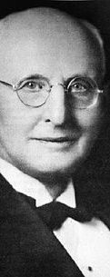
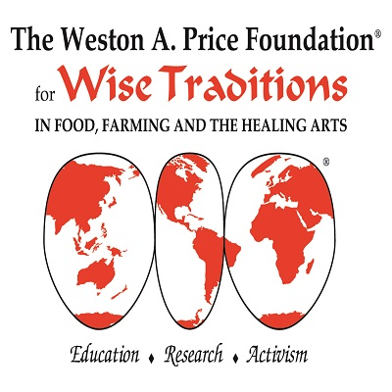
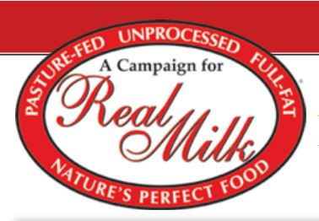
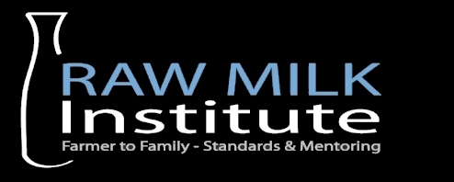
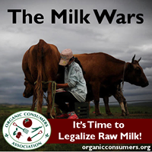
Hearing from Organizations Challenging Pro-Pasteurization
  Sally Fallon Morell, founder of Weston A. Price Foundation
  Ted Beals, MD, WAPF board member
    Real Milk Campaign, advocates meticulous
    documentation of scientific evidence for
    benefits and risks
  Mark McAfee, founder of Raw Milk Institute (RAWMI)
    observes raw milk renaissance and advocates food safety
    plans, testing and Common Standards, and HACCP-style
    management to minimize risks on farm and at retail markets
  Ronnie Cummins, national director of the Organic Consumers Organization
    Healthy Raw Milk Campaign; Buy Local, Organic, and Fair Made

Slide 37
Some Common Ground for Safe Milks
Both sides of milk wars adopt similar technology-dependent principles of milk hygiene
  thoroughly disinfecting all equipment at regular intervals
  preventing it from coming in contact with surfaces other than stainless steel, glass, or inert plastics
  milking via machine
  promptly chilling and refrigerating during storage and transport
  keeping milk sealed from exposure to the open air
Use of coliform counts
  hygienic quality indicator (not predictive of presence or counts of pathogens)
Use of somatic cell count
  indicator of animal health (not predictive of presence or counts of pathogens)
(Specific pathogen testing? Presence or levels?)

Slide 38
Working towards Resolution of the Continuing Milk Wars
SRA project gathers evidence on both sides of milk wars around the globe
Headlines on both sides of war: raw milk as innately hazardous poison and safe food
2017
2015
UK FSA finding ‘raw drinking milk’ safe
Risk increases with pasteurization temperature
Stasiewicz listeriosis risk assessment (2014)
Food safety plan and testing
RAWMI Common Standards
Raw Milk Institute (RAWMI) founded 2011
Likelihood illness very low (2 per 10¹⁵) per raw milk serving
Latorre listeriosis risk assessment (2011)
2007

Slide 39
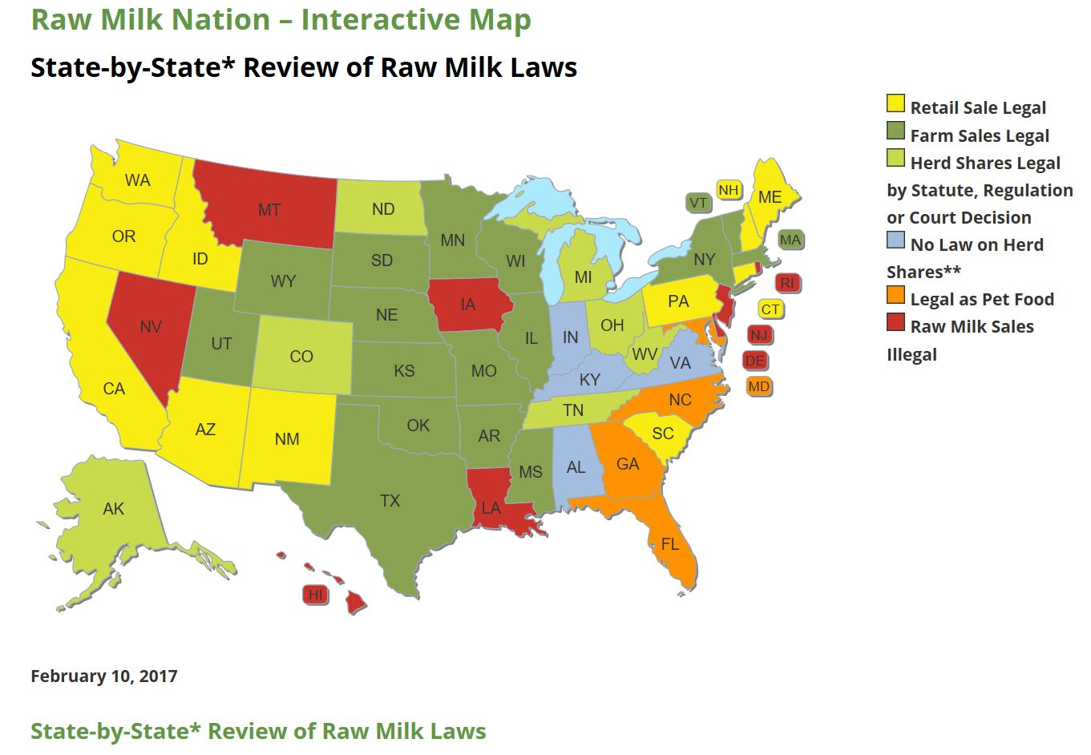
Current State Regulations in US
States can license dairies for sale of fresh unprocessed (certified raw) milk at retail, licensed farm stores, or as ‘cow-/herd- share’ operations or prohibit sale.
NY State requires Quality Milk Production Services (QMPS) program and periodic testing for coliforms and specific pathogens.
Federal regulators advise raw milk is an inherently hazardous poison.
https://www.farmtoconsumer.org/

Slide 40
Outline: Closing 2017 Webinar Series
Microbiological discoveries impacting risk assessment,
communication, and management
‘Milk wars’ around the globe
  US history (Mendelson, 2011)
  Australia history
  New Zealand history
  UK history
Evidence considered in top-down and bottom-up approaches

Slide 41
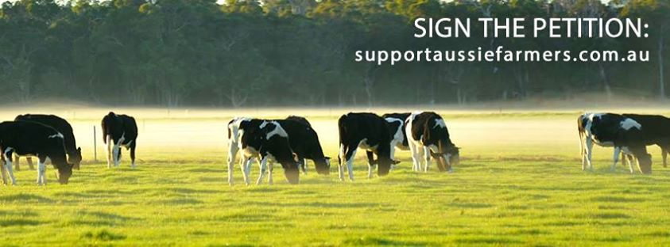
Australia
Sale of raw milk illegal since 1940s
  Potential presence of pathogenic bacteria
    Campylobacter, pathogenic E. coli, and Listeria, Salmonella, Staphylococcus aureus
Position from Victorian Department of Health and Human Services
  https://www.betterhealth.vic.gov.au/health/conditionsandtreatments/raw-unpasteurised-milk
2014 outbreak: 4 cases of serious illness (one fatality) in children who consumed cosmetic bath milk product
Cow-/herd- shares illegal
Some consumer organizations oppose prohibition

Slide 42
Outline: Closing 2017 Webinar Series
Microbiological discoveries impacting risk assessment,
communication, and management
‘Milk wars’ around the globe
  US history (Mendelson, 2011)
  Australia history
  New Zealand history
  UK history
Evidence considered in top-down and bottom-up approaches

Slide 43
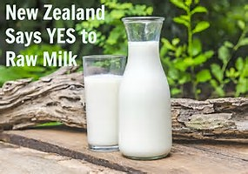
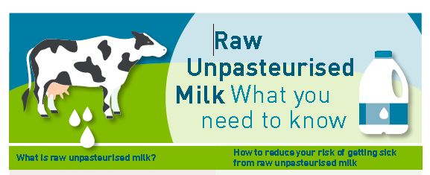
New Zealand
MPI notes concern about raw drinking milk and underground markets due to potential presence of pathogenic bacteria.
  Primary concern for Campylobacter and STEC (pathogenic E. coli)
  Lower concern for salmonellosis (less severe disease) and listeriosis (no observed milk-related illnesses)
  http://www.foodsafety.govt.nz/industry/sectors/dairy/raw-milk/
Raw milk has been available under various regulations
  Food Act 1981 with limit 5 L/day for personal/family use
  Animal Products Act 1999 requiring Risk Management Programme
  Animal Products (Raw Milk Products Specifications) Notice 2009
Registered farms began selling raw milk via home
delivery or from licensed farm stores and vending
machines since 2016.
Regulators advise boiling raw milk before consumption.

Slide 44
Outline: Closing 2017 Webinar Series
Microbiological discoveries impacting risk assessment,
communication, and management
‘Milk wars’ around the globe
  US history (Mendelson, 2011)
  Australia history
  New Zealand history
  UK history
Evidence considered in top-down and bottom-up approaches

Slide 45
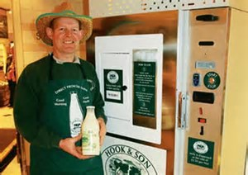
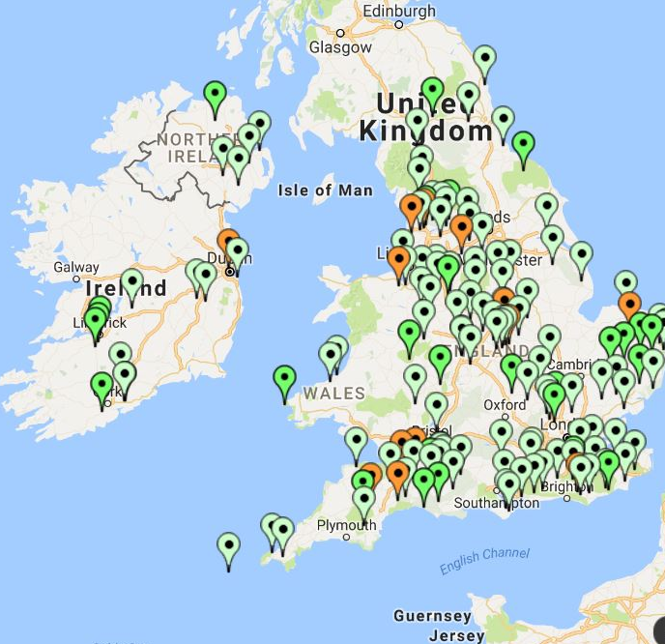
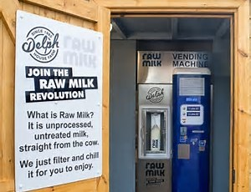
United Kingdom
Raw drinking milk safe for healthy people, compulsory warning label
(UK FSA, 2015)
Increasing numbers of licensed farms and consumers?
http://www.zeemaps.com/view?group=208677&x=-3.288567&y=52.633852&z=12

Slide 46
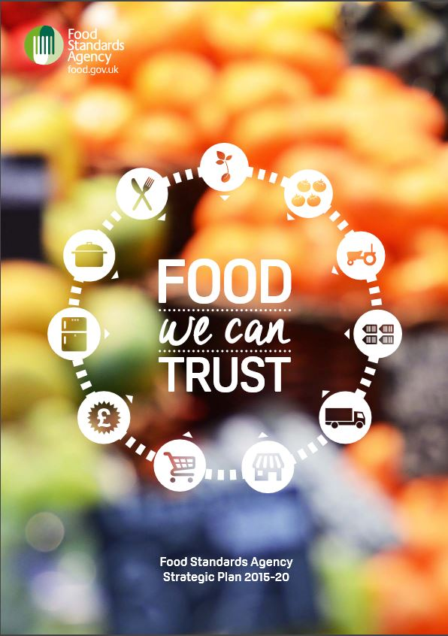
UK Food Standards Agency (FSA) Approaches
Government department run by independent board acting in public interest to assess, manage, and communicate risks using evidence-based methods
(Paul Cook, 2016)
Assess using best scientific advice and acknowledge uncertainties;
re-assess in the light of new evidence (qualitative or quantitative)
  Top-Down from epidemiologic evidence from outbreaks
  to define scale and impact of sources
  Bottom-Up from data for microbiology, predictive microbiology,
  and dose-response relationships linked with human health/disease
Manage: consistent, proportionate; not claim to eliminate
risk (no foods ZERO risk)
Communicate: consultation, openness, honesty, role of the media
https://www.foodprotection.org/upl/downloads/meeting/program-overview/573f434f8bd893377a707.pdf

Slide 47
Outline: Closing 2017 Webinar Series
Microbiological discoveries impacting risk assessment,
communication, and management
‘Milk wars’ around the globe
  US history (Mendelson, 2011)
  Australia history
  New Zealand history
  UK history
Evidence considered in top-down and bottom-up approaches

Slide 48
Some Examples of Top-Down, Bottom-Up Assessments for US
Top-Down, outbreaks reported from 1993-2014 associated with multiple dairy commodities and four pathogens
  Headrich et al., (1998; 1973-1992)
  Langer et al. (2012; 1993-2006)
  Mungai et al. (2015; 2007-2012)
  Costard et al. (2017; 2009-2014)
Bottom-Up, Listeria monocytogenes
  FDA/FSIS (2003)
  Latorre et al. (2011)
  Stasiewicz (2014)
Additional assessments including those prepared by
FSANZ, AFSCA, MPINZ will be considered in
next phases of Joint SRA RO Project

Slide 49
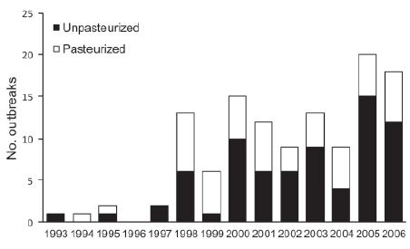
Top-Down Evidence from US Outbreaks (1993-2006)
Neither Milk is Risk-Free
Pathogens for Dairy Outbreaks
Bacillus (pasteurized)
Brucella (unpasteurized)
Campylobacter (both)
Clostridium (pasteurized)
Listeria (both)
Norovirus (pasteurized)
Salmonella (unpasteurized)
Shigella (both)
Staphylococcus (both)
STECs/VTECs (unpasteurized)
46 milk outbreaks 930 cases 71 hospitalized
10 milk outbreaks 2,098 cases 20 hospitalized
Number of dairy associated outbreaks, 1993-2006 (Langer et al., 2012)
Uncertainties
Any of the 46 outbreaks associated with unpasteurized milk representative of certified raw milk produced on licensed farms?
Raw data not available from study authors

Slide 50
Correlative Evidence from Epidemiologic Studies
Data from outbreaks may be poorly predictive of future outbreaks
or the numbers of associated illnesses, hospitalizations, and deaths
Recent fatal listeriosis outbreak from commodity estimated by FDA/FSIS (2003) as very low risk: ice cream prepared from pasteurized milk served in hospital, no deaths for non-hospitalized consumers (Pouillot et al., 2016)
Consider Solenne Costard’s analysis presented at SRA in 2014 and published this year in Emerging Infectious Diseases
  Raw data provided by Solenne and her co-authors (Costard et al., 2017) raise
  questions about the analysis and its interpretation (details in backup slide)
  For states regulating raw milk, claims for ‘unpasteurized dairy products’ not supported
    cause 760 illnesses and 22 hospitalizations per year, mostly from Salmonella and Campylobacter
    840 (95% credibility interval 611-1,158) times more illnesses and 45 (95% credibility
    interval 34-59) times more hospitalizations than pasteurized products

Slide 51
NY State Outbreaks over 18 Years
(CDC FOOD Tool)
Data for all 18 years of surveillance currently available in CDC FOOD tool (July, 2017 download)
No outbreaks associated with Listeria, Salmonella, STEC, or Staphyloccus for nonpasteurized milk
All 10 outbreaks associated with Campylobacter

Slide 52
Bottom-Up Listeriosis Predictions for Milks
Perception that raw milk is poison is inconsistent with both FDA/FSIS (2003) and Latorre et al. (2011) risk estimates:
Pasteurized Milk
  Unpasteurized Milk
90.8 deaths per year
(high risk)
3.1 deaths per year
(moderate risk)
10⁻⁹ per serving or 1 fatal case in 1,000,000,000 exposures at selected doses (moderate risk)
7x10⁻⁹ per serving or 7 fatal cases in 1,000,000,000 exposures at selected doses (high risk)
~2x10⁻¹⁵ per serving or 2 cases in 1,000,000,000,000,000 exposures (very low risk)
FDA/FSIS
Latorre

Slide 53
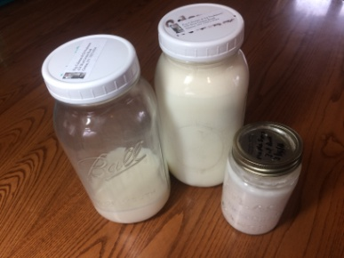
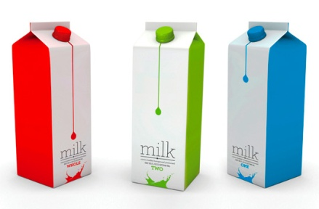
Research Supporting Evidence-Based Policies for Listeriosis?
    Some governments regulate Ready to Eat Foods that…
support growth as unsafe (adulterated) if
1 bacteria or colony forming unit (CFU)/mL Listeria is detected.
do not support growth as adulterated only if
>100 CFU/mL
Listeria is detected.
Evidence for growth/no growth of pathogens in certified raw milk at natural levels of contamination (1 to 10 CFU/mL)?
If no growth for Listeria, raw milk at <100 CFU/mL could be considered unadulterated (acceptable or tolerable or ‘safe’)
Milk microbiota studies could better characterize microbes associated with suppressive effects on Listeria and other pathogens

Slide 54
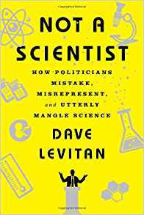
Difficulties of Communicating Scientific Information about Microbial Ecosystems
Dave Levitan’s List of Errors (2017)
    Oversimplification Cherry-pick
    Butter-up and undercut Demonizer
    Blame the blogger Ridicule and dismiss
    Literal nitpick Credit snatch
    Certain uncertainty Blind eye to follow-up
    Lost in translation Straight-up fabrication
    Conspicuous silence

Slide 55
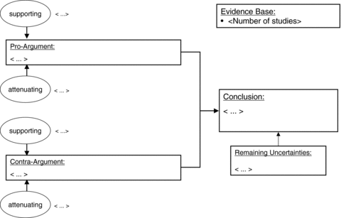
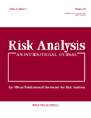
Evidence Maps: Communicating Risk Assessments in Societal Controversies:
The Case of Engineered Nanoparticles
Future: Compile and Map the Evidence, Deliberate …
Risk Analysis
Volume 31, Issue 11, pages 1770-1783, 15 NOV 2011 DOI: 10.1111/j.1539-6924.2011.01725.x
http://onlinelibrary.wiley.com/doi/10.1111/j.1539-6924.2011.01725.x/full#f1
Notes:
Template for an evidence map.
IF THIS IMAGE HAS BEEN PROVIDED BY OR IS OWNED BY A THIRD PARTY, AS INDICATED IN THE CAPTION LINE, THEN FURTHER PERMISSION MAY BE NEEDED BEFORE ANY FURTHER USE. PLEASE CONTACT WILEY'S PERMISSIONS DEPARTMENT ON PERMISSIONS@WILEY.COM OR USE THE RIGHTSLINK SERVICE BY CLICKING ON THE 'REQUEST PERMISSIONS' LINK ACCOMPANYING THIS ARTICLE. WILEY OR AUTHOR OWNED IMAGES MAY BE USED FOR NON-COMMERCIAL PURPOSES, SUBJECT TO PROPER CITATION OF THE ARTICLE, AUTHOR, AND PUBLISHER.

Slide 56
Back to Warner North

Slide 57
Five Key Points
Getting the science right
Getting the right science
Getting the right participation
Getting the participation right
Developing an accurate, balanced, and informative synthesis.
Source: Understanding Risk (1996, pages 6-7).

Slide 58
Where Are We in This Process?
Points 1 to 4 : just beginning to assemble the science, participants – and get these “right.” We welcome further participation!
Point 5: Synthesis is quite a distance away.

Slide 59
Where Are We in This Process?
Points 1 to 4 : just beginning to assemble the science, participants – and get these “right.” We welcome further participation!
Point 5: Synthesis is quite a distance away.
But let us give you personal viewpoints,
as of now.

Slide 60
Some Insights to Date:
Microbial ecosystems are complicated to understand, model, and communicate about to stakeholders.
Culture-independent methods used in first decade of microbiome research are transforming understanding of ‘superorganisms’, immunology, and microbial ecology of milks.
Further research and further dialogue is needed for evidence-based regulation considering microbiota of milks.
High value of further information likely based on high potential for better risk management to achieve benefits and balance, reduce risks.

Slide 61
Some Probiotic Examples – Clinical Trials
Patricia L. Hibberd et al. “No evidence of harms of probiotic Lactobacillus rhamnosus GG ATCC 53103 in healthy elderly-A phase I open label study to assess safety, tolerability and cytokine responses” Public Library of Science One, 2014; 9(12):e113456.
  Summary: elderly volunteers (65-80 years of age) treated twice daily with 10¹⁰ cfu of probiotic (Lactobacillus rhamnosus) for 28 days suffered no serious adverse events, and an inflammatory cytokine that could disrupt gut homeostatis and impact health decreased transiently.
Donald G. MacNeil, Jr., “Protected From Bacteria by Bacteria” Source: New York Times, Health, August 21, 2017:
    https://www.nytimes.com/2017/08/21/health/how-to-prevent-deadly-infection-in-babies-good-bacteria.html?mcubz=0
  Summary from Nature, August, 2017: sample ATCC-202195 of Lactobacillus plantarum from a healthy 11-month old Maryland child fed for one week reduced sepsis in babies in rural India by 40%; trial end early because it was judged unethical to deny treatment to placebo babies.
  Last paragraph: “…getting the money to do such studies is hard experts say, because of prejudices against probiotics at many funding institutions, which view their use as naturopathy rather than evidence-based medicine.”

Slide 62
Paradigm Shifts Are Difficult Even in the Scientific Community
References:
Thomas Kuhn, The Structure of Scientific Revolutions, Chicago, University of Chicago Press, 1962. Now in 50th Anniversary Edition.ISBN-13: 978-0226458083.
Yuval Noah Harari, Sapiens, London: Vintage books, 2011. See especially Chapter 14, “Discovery of Ignorance,” p. 275 – 306.

Slide 63
Paradigm Shifts Are Difficult Even in the Scientific Community
References:
Thomas Kuhn, The Structure of Scientific Revolutions, Chicago, University of Chicago Press, 1962. Now in 50th Anniversary Edition.ISBN-13: 978-0226458083.
Yuval Noah Harari, Sapiens, London: Vintage books, 2011. See especially Chapter 14, “Discovery of Ignorance,” p. 275 – 306.
Risk Community has challenges to address
for microbiota of milks !

Slide 64
Acknowledgments of Collaborators on Joint SRA Project
SRA Webinar Series Speakers
  Rodney Dietert, Cornell University
  Michelle McGuire, Washington State University
  Mark McGuire, University of Idaho
Project Participants to Date
  Heather Lynch, New England SRA
  Steve Corin, Australia/New Zealand SRA
  Stephen Cobb, New Zealand EPA
  Naomi Cogger, Australia/New Zealand SRA
  Paul Cook, UK Food Standards Agency
  Tom Ross, University of Tasmania, Australia
  Tanya Soboleva, Ministry for Primary Industries, New Zealand
SRA Secretariat and Officers
  Ann Bostrom, University of Washington, SRA Fellow
  Christopher Clark, George Mason University, SRA Risk Communication Specialty Group Chair
  Robin Dillon Merrill, Georgetown University, SRA Education Committee Chair
  Michele Stephenson, Upstate NY SRA Webmaster

Slide 65


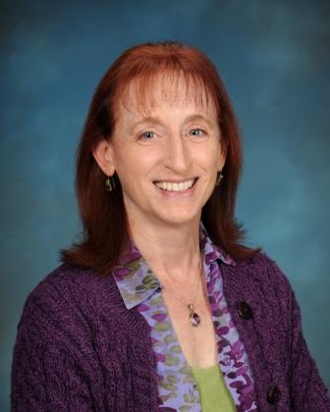
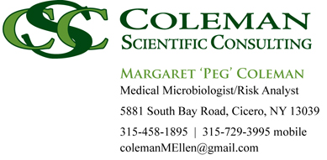
  Questions ?
  More Information and Resources Appended
northworks@mindspring.com
peg@colemanscientific.org

Slide 66
Back-up Slides

Slide 67
Free Resource for Consumers
(American Academy of Microbiology, 2014)
free download from American Society for Microbiology (ASM) at http://academy.asm.org/index.php/faq-series/ 5122-humanmicrobiome

Slide 68
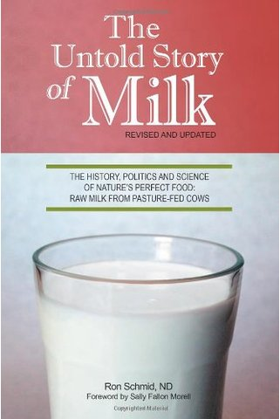
Food Microbiology and Risk Resources
(Jaykus et al., 2009)
(Working Towards Food We Can Trust; FSA, 2015, free download at food.gov.uk)
(Schmid, 2009)
(McGuire et al., 2017)

Slide 69

Other Resources
(Yong, 2017)
(Alda, 2017)
(Dietert, 2016)
(Levitan, 2017)

Slide 70
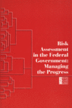
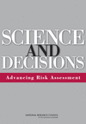

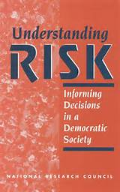
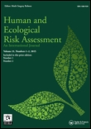
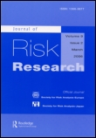
Risk Resources
Many excellent resources (books, reviews, and technical papers) available in published literature, some free full text
  National Academy of Sciences, the National Academies Press (more technical, but free downloads
  at http://www.nap.edu/)
  Technical journals (fees for online access without subscription)

Slide 71
Some Requirements for Selling Certified Raw Milk in NY State
Brucellosis ring test
  No longer required in NY and other validated brucellosis-free states; 9 CFR 78.43
Tuberculosis test for each animal
  No longer required in NY and other validated TB-free states
Quality Milk Production Services (QMPS) program
  Each animal tested for E. coli and pathogens including Staphylococcus aureus
Monthly or quarterly milk sample tested for coliforms and pathogens including Salmonella, Listeria, E. coli O157:H7, Campylobacter, Staphylococci
Satisfactory farm water test
Farm inspections at least twice a year
  Sanitary conditions
  Health of cows
  Health of individuals working on farm
71

Slide 72
Data NY State Outbreaks Associated with
Nonpasteurized Milk (1998-2015)
Currently ~40 Licensed Dairies in NY State
No Salmonellosis, E. coli enteritidis, Listeriosis, or Staphylococcus aureus Illness Outbreaks
Data for all 18 years of surveillance currently available in CDC FOOD tool (July, 2017 download)
All 10 outbreaks attributed to Campylobacter; no deaths reported for this 18-year period

Slide 73
Correlative Evidence from US Epidemiologic Studies
Mungai et al. (2015; 2007-2012)
  Data for pasteurized milk or total outbreak statistics not reported for context
  ‘Black market’ milk, not certified raw milk from licensed farms, is associated with majority of illness outbreaks
Costard et al. (2017; 2009-2014)
  Pooling of milk and cheese for convenience of analysis problematic
  Outbreaks associated with certified raw milk from licensed dairies not reported
  Causality not demonstrated in this study
  Generalizing from dairy outbreaks in the past invalid for predicting certified raw milk outbreaks, cases, and hospitalizations in the future
  Model predictions most sensitive to the adjustment factors applied to the raw data
  For states regulating raw milk, claims for ‘unpasteurized dairy products’ not supported
    cause 760 illnesses and 22 hospitalizations per year, mostly from Salmonella and Campylobacter
    840 (95% credibility interval 611-1,158) times more illnesses and 45 (95% credibility interval 34-59)
    times more hospitalizations than pasteurized products

Slide 74
Bottom-Up: Listeriosis Relative Risks for Dairy Commodities Very Low to High
FDA/FSIS, 2003
Very high and high risk foods (upper left) presumed to support growth, including BOTH milks (pasteurized and unpasteurized)
Very low and low risk foods (lower right), including frozen foods and hard cheeses, presumed to have intrinsic or extrinsic factors to prevent the growth or are processed to alter the normal characteristics of food
Recent fatal outbreak from commodity estimated very low risk: ice cream prepared from pasteurized milk served in hospitals, not consumed in general population (Pouillot et al., 2016)

Slide 75
Evidence for Updating Assumptions about Listeria Growth
At refrigeration temperatures of 41-43 °(F):
Listeria growth rate assumed by FDA/FSIS for both pasteurized and unpasteurized milk
  0.257 cfu/g/day
Listeria growth rate increased with increasing pasteurization temperature for 25 seconds in recent university study
  0.503 cfu/mL/day for milk treated at 162°(F)
  0.562 cfu/mL/day for milk treated at 180°(F)
Higher temperature also significantly decreased the time before Listeria growth began (shorter lag) and increased maximal growth (higher maximal density, N_{max}), causing higher growth of the pathogen at the higher pasteurization temperature
Exposure is underestimated for PASTEURIZED milk in FDA/FSIS assessment!
(FDA/FSIS, 2003; Stasiewicz et al, 2014)
Notes:
Pseudomonas spp dominate total bacterial communities in raw milk (standard plate count/total viable plate count/total aerobic plate count) at refrigeration temperatures

Slide 76
Pasteurized (and Certified Raw) Milks Not Risk-Free
Pasteurization reduces pathogen numbers but does not kill all bacteria present.
Milk is a better growth medium for Listeria after heat treatment than before (Stasiewicz et al., 2014).
The greater the volume of milk produced and distributed for consumption, the wider the effect when something goes wrong.
Sterile milk, inside or outside the udder, is a myth now that the first decade of microbiome studies are published.
The microbiome of post-pasteurization milk includes similar organisms and diversity as raw milk, but lower counts (Quigley et al., 2013a,b).
Need for both sides of milk wars to consider all the evidence and address the true problem.

Slide 77
Milk Wars in Canada
Economics: Milk Control Act/Milk Control Act intended to stabilize pricing (milk glut, falling prices; subsidies; limit supply)
Sale of raw milk illegal since 1981 (Health Canada)
  Potential presence of pathogenic bacteria
    Listeria, pathogenic E. coli, and Salmonella
  https://www.canada.ca/en/health-canada/services/food-nutrition/food-safety/information-product/statement-about-drinking-milk.html
Ontario law prohibits selling or giving away raw milk
Dairy farmer Michael Schmidt (Glencolton Farm) awaiting decision in courts
  Legality of farm-share, 200-member cooperative farm?
  “It’s a total police state when it comes to raw milk here because there’s absolutely no leniency on any level. They are saying it’s the most dangerous substance you can think of and should never be allowed. There’s not even a proper scientific debate about it. It’s all on an emotional, fear-based level.”
  Raw Milk Xenophobia?

